Slide 1
Second-generation p-values: Introduction and Applications
Jeffrey D. Blume,
PhD
Megan H. Murray, almost PhD (July 6th defense)
and
School of Data Science
University of Virginia
Department of Biostatistics
Vanderbilt University

Slide 2
Timeline
9:00am - 9:50am Slides 1-?
10 min break
10:00am - 10:30am Coding Example
10 min break
10:40am – 11:30pm Slides ?-?
10 min break
11:40am - 12:00pm Coding Example
12:00pm - 12:30pm Questions

Slide 3
Intro?
Github.com/
Make sure everyone can access it

Slide 4
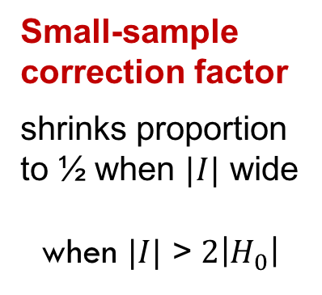
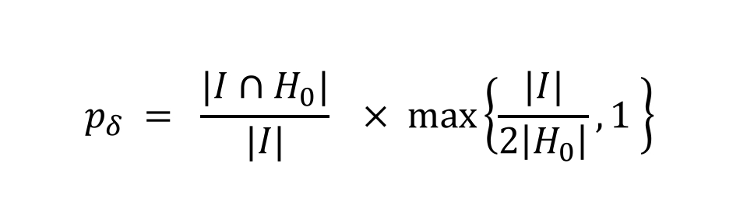
Definition
Second-generation p-value (SGPV)
$$p_{δ} = \frac{|I∩H_{0}|}{|I|}× max\left\{\frac{|I|}{2\left|H_{0}\right|},1 \right\}$$
Proportion of data-supported hypotheses that are also
null hypotheses
Small-sample correction factor
shrinks proportion to ½ when $|I|$ wide
when $|I|$ > $2\left|H_{0}\right|$

Slide 5
Equivalence Tests
Megan Paper 2
Table
Graph scatter

Slide 6
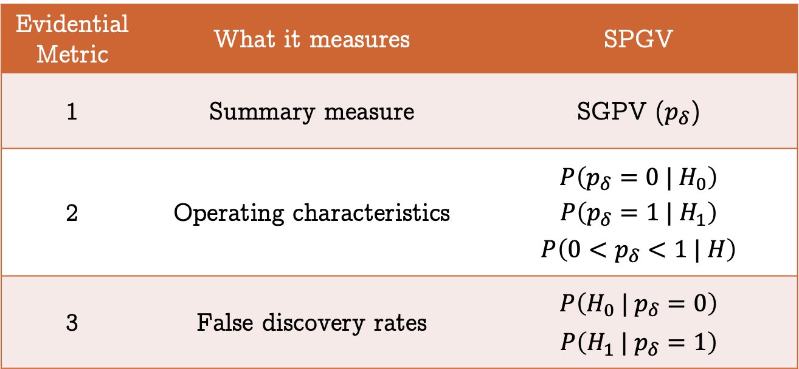
Second-generation p-value
StatisticalEvidence.com
Statistical properties in TAS & PLOS One
Retains strict error control
Evidential Metric | What it measures | SPGV
1 | Summary measure | SGPV ($p_{δ}$)
2 | Operating characteristics | $$P\left(p_{δ}=0 | H_{0}\right)$$ $$P\left(p_{δ}=1 | H_{1}\right)$$ $$P\left(0<p_{δ}<1 | H\right)$$
3 | False discovery rates | $$P\left(H_{0} | p_{δ}=0\right)$$ $$P\left(H_{1} | p_{δ}=1\right)$$

Slide 7
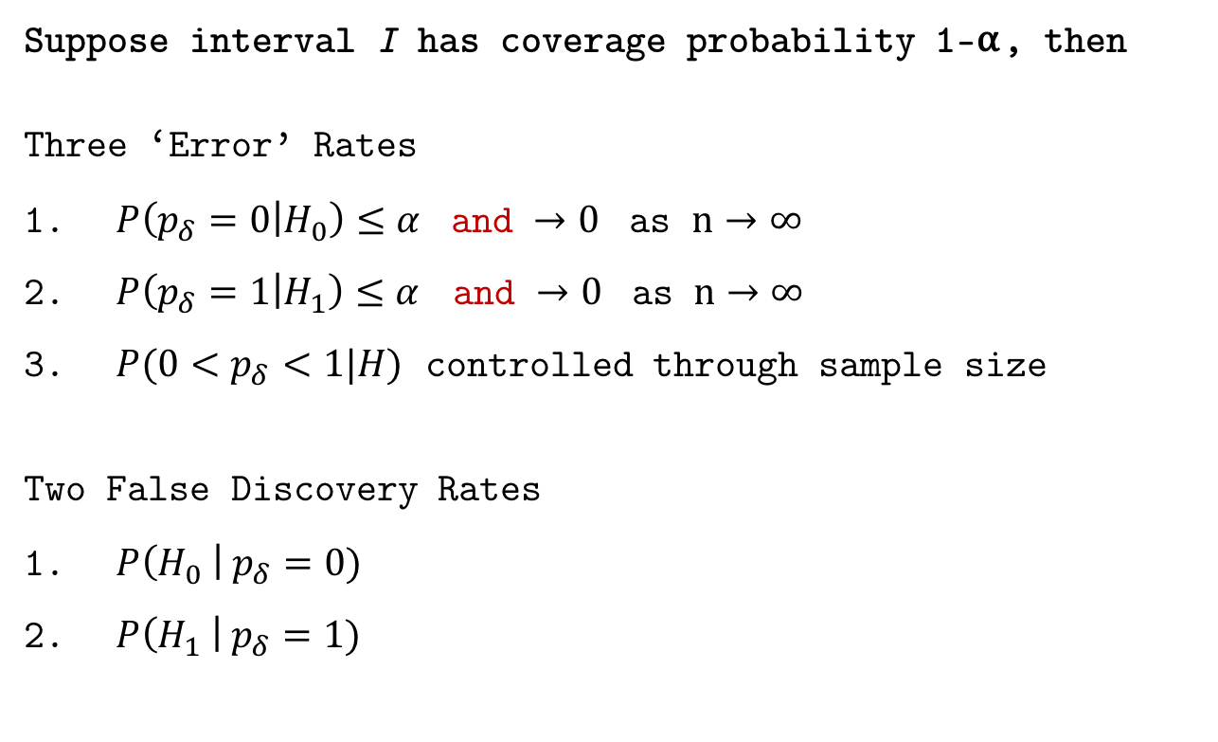
Statistical Properties
Suppose interval I has coverage probability 1-⍺, then
Three ‘Error’ Rates
$P\left(p_{δ}=0 | H_{0}\right)≤α$ and $→0$ as $n→∞$
$P\left(p_{δ}=1 | H_{1}\right)≤α$ and $→0$ as $n→∞$
$P(0<p_{δ}<1|H)$ controlled through sample size
Two False Discovery Rates
$P\left(H_{0} \right| p_{δ}=0)$
$P\left(H_{1} \right| p_{δ}=1)$
Will examine these first
Will graph to illustrate

Slide 8
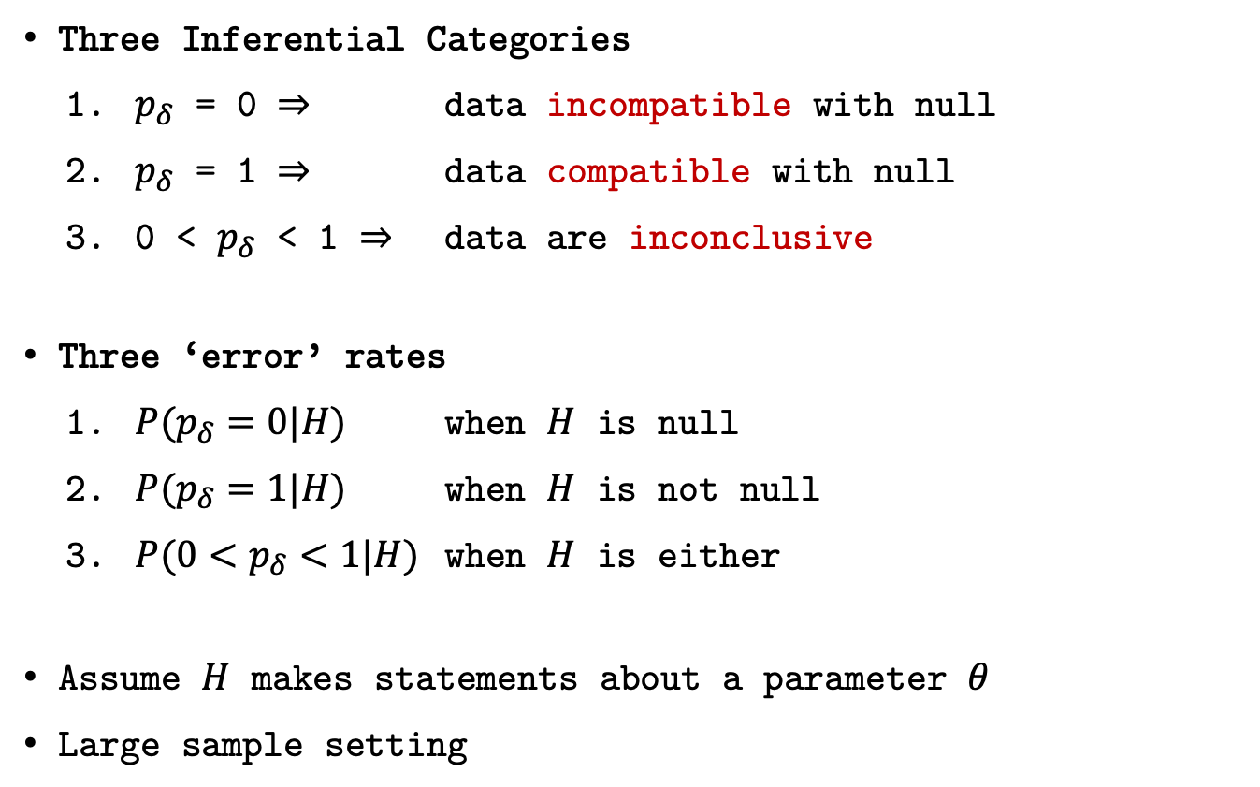
Statistical Properties
Three Inferential Categories
$p_{δ}$ = 0 $⇒$ data incompatible with null
$p_{δ}$ = 1 $⇒$ data compatible with null
0 < $p_{δ}$ < 1 $⇒$ data are inconclusive
Three ‘error’ rates
${P(p}_{δ}=0|H)$ when $H$ is null
${P(p}_{δ}=1|H)$ when $H$ is not null
${P(0<p}_{δ}<1|H)$ when $H$ is either
Assume $H$ makes statements about a parameter $θ$
Large sample setting

Slide 9
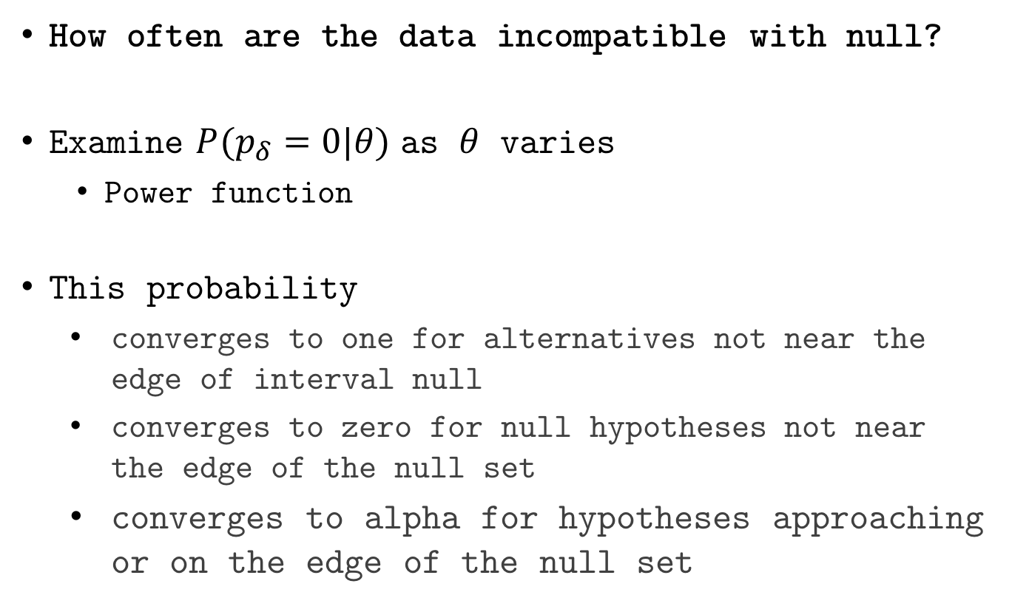
Statistical Properties
How often are the data incompatible with null?
Examine ${P(p}_{δ}=0|θ)$ as $θ$ varies
Power function
This probability
converges to one for alternatives not near the edge of interval null
converges to zero for null hypotheses not near the edge of the null set
converges to alpha for hypotheses approaching or on the edge of the null set

Slide 10
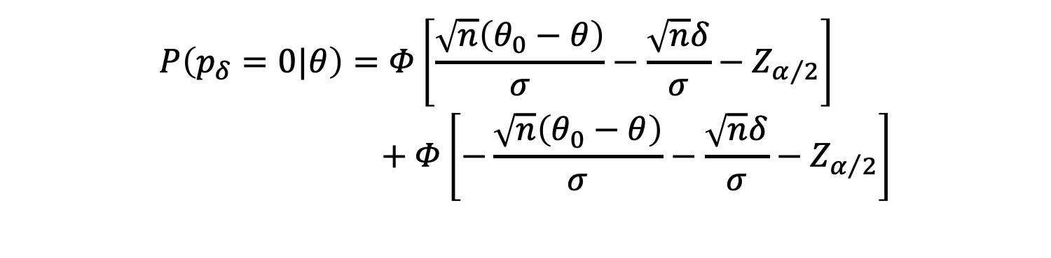
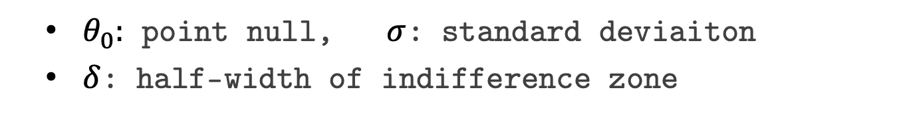
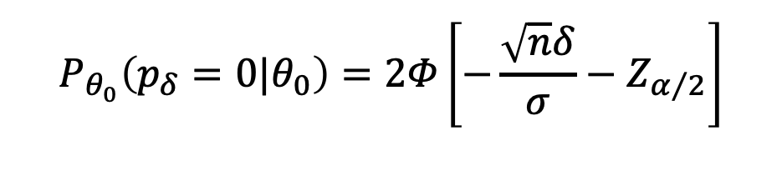
‘Power’ Function
$θ_{0}:$ point null, $σ$: standard deviaiton
$δ$: half-width of indifference zone
$$P\left(p_{δ}=0|θ\right)=Φ\left[\frac{\sqrt{n}\left(θ_{0}−θ\right)}{σ}−\frac{\sqrt{n}δ}{σ}−Z_{α/2}\right] \\ + Φ\left[−\frac{\sqrt{n}\left(θ_{0}−θ\right)}{σ}−\frac{\sqrt{n}δ}{σ}−Z_{α/2}\right]$$
$$P_{θ_{0}}\left(p_{δ}=0|θ_{0}\right)=2Φ\left[−\frac{\sqrt{n}δ}{σ}−Z_{α/2}\right]$$

Slide 11

$$P\left(p_{δ}=0|θ\right)$$

Slide 12
Compare with standard methods
Second-generation p-value vs. Bonferroni correction
Adjusted for {10, 100, 7128} comparisons
Leukemia data example
Remember SGPV are not adjusted for comparisons
Discuss?

Slide 16
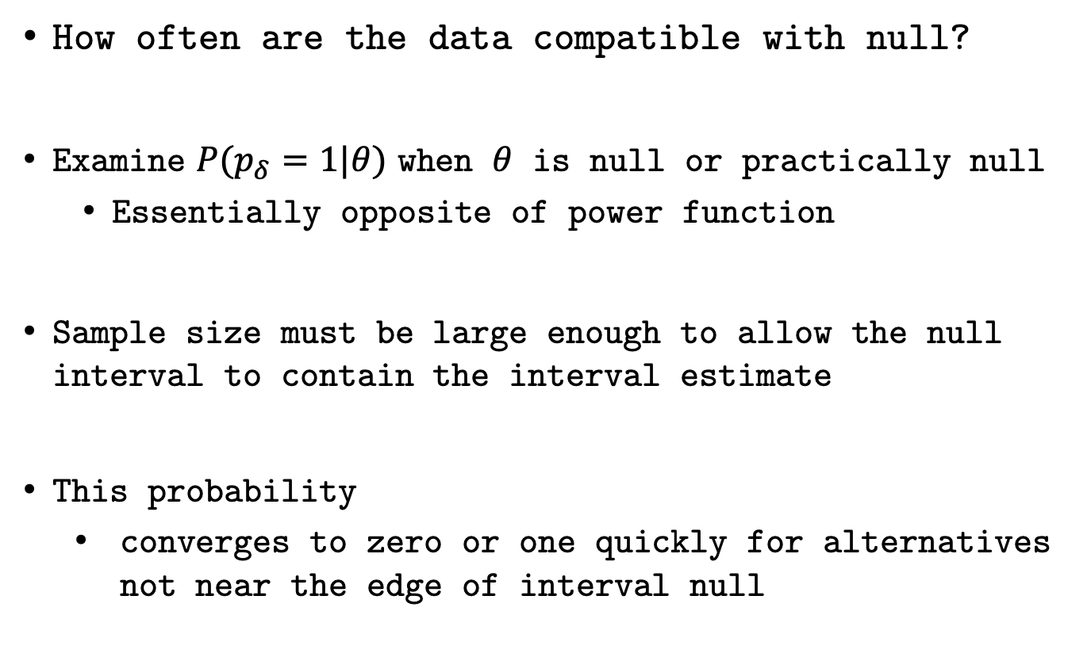
Compatible with Null
How often are the data compatible with null?
Examine ${P(p}_{δ}=1|θ)$ when $θ$ is null or practically null
Essentially opposite of power function
Sample size must be large enough to allow the null interval to contain the interval estimate
This probability
converges to zero or one quickly for alternatives not near the edge of interval null

Slide 17
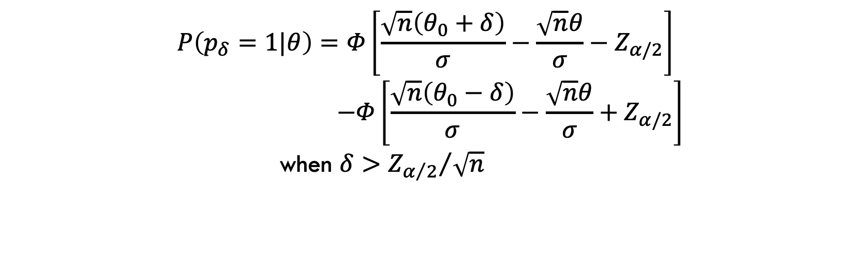
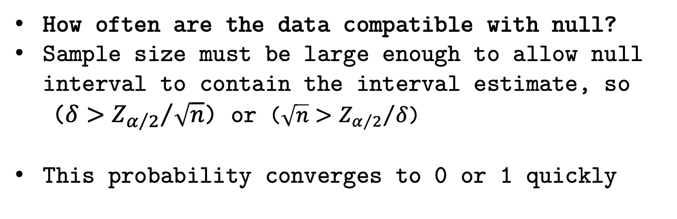
‘Null Power’ Function
How often are the data compatible with null?
Sample size must be large enough to allow null interval to contain the interval estimate, so
($δ>{Z_{α/2}}/{\sqrt{n}}$) or ($\sqrt{n}>{Z_{α/2}}/δ$)
This probability converges to 0 or 1 quickly
$$P\left(p_{δ}=1|θ\right)=Φ\left[\frac{\sqrt{n}\left(θ_{0}+δ\right)}{σ}−\frac{\sqrt{n}θ}{σ}−Z_{α/2}\right]$$
$$−Φ\left[\frac{\sqrt{n}\left(θ_{0}−δ\right)}{σ}−\frac{\sqrt{n}θ}{σ}+Z_{α/2}\right]$$
when $δ>{Z_{α/2}}/{\sqrt{n}}$

Slide 18

$$P\left(p_{δ}=1|θ\right)$$

Slide 19
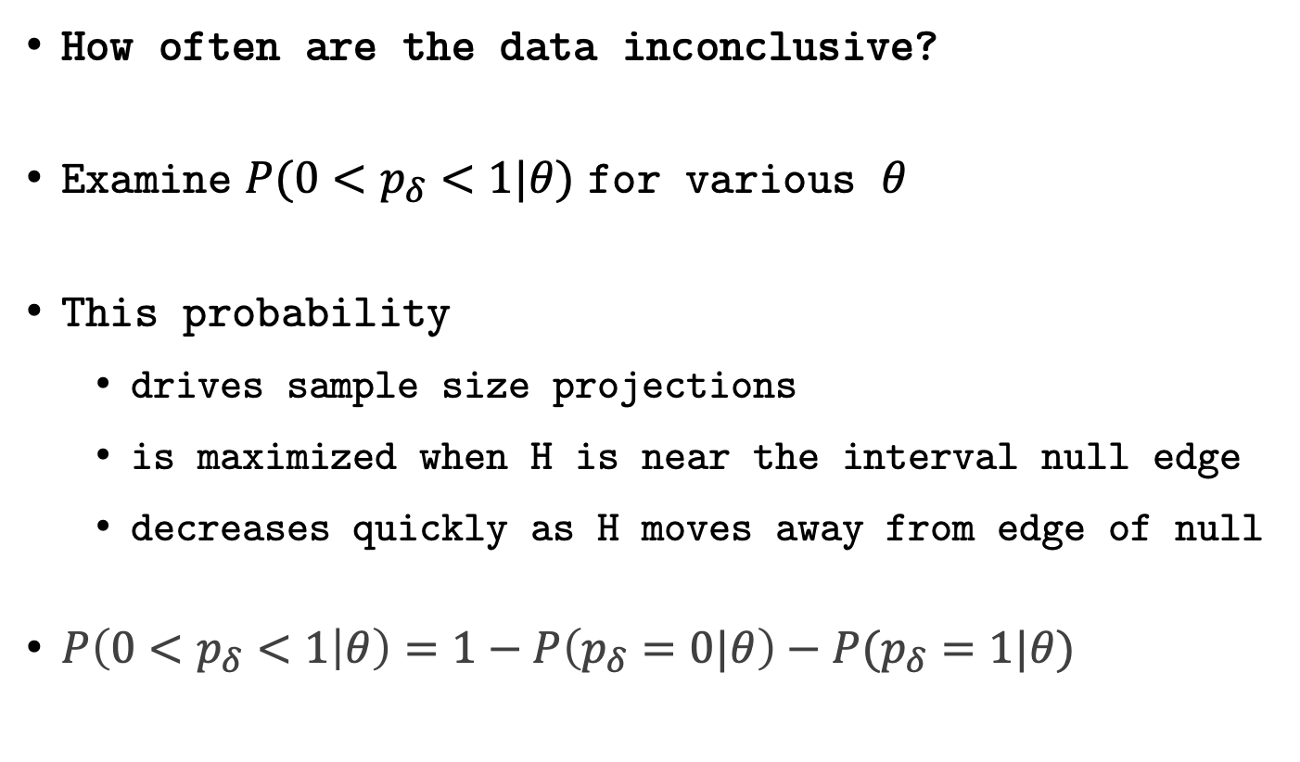
Probability of Inconclusive Data
How often are the data inconclusive?
Examine ${P(0<p}_{δ}<1|θ)$ for various $θ$
This probability
drives sample size projections
is maximized when H is near the interval null edge
decreases quickly as H moves away from edge of null
$P\left(0<p_{δ}<1 | θ\right)=1−P\left(p_{δ}=0|θ\right)−P(p_{δ}=1|θ)$

Slide 20
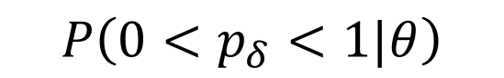
$$P\left(0<p_{δ}<1|θ\right)$$

Slide 21
$$P\left(0<p_{δ}<1|θ\right)$$

Slide 22
Paper 3

Slide 23
Statistical Properties
Suppose interval I has coverage probability 1-⍺, then
Three ‘Error’ Rates
$P\left(p_{δ}=0 | H_{0}\right)≤α$ and $→0$ as $n→∞$
$P\left(p_{δ}=1 | H_{1}\right)≤α$ and $→0$ as $n→∞$
$P(0<p_{δ}<1|H)$ controlled through sample size
Two False Discovery Rates
$P\left(H_{0} \right| p_{δ}=0)$
$P\left(H_{1} \right| p_{δ}=1)$

Slide 24
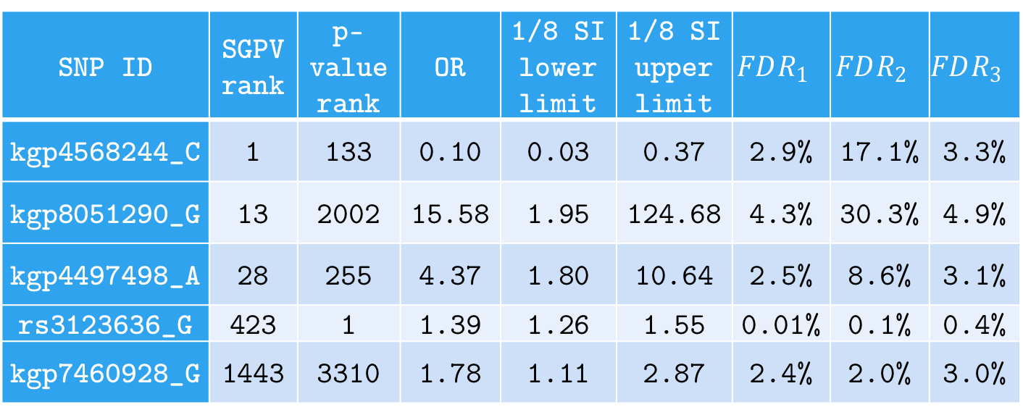
False Discovery Rates
FDR for 5 SGPV=0 findings; computed under various null and alternative configurations (w/ flat prior).
SNP ID | SGPV rank | p-value rank | OR | 1/8 SI lower limit | 1/8 SI upper limit | $$FDR_{1}$$ | $$FDR_{2}$$ | $$FDR_{3}$$
kgp4568244_C | 1 | 133 | 0.10 | 0.03 | 0.37 | 2.9% | 17.1% | 3.3%
kgp8051290_G | 13 | 2002 | 15.58 | 1.95 | 124.68 | 4.3% | 30.3% | 4.9%
kgp4497498_A | 28 | 255 | 4.37 | 1.80 | 10.64 | 2.5% | 8.6% | 3.1%
rs3123636_G | 423 | 1 | 1.39 | 1.26 | 1.55 | 0.01% | 0.1% | 0.4%
kgp7460928_G | 1443 | 3310 | 1.78 | 1.11 | 2.87 | 2.4% | 2.0% | 3.0%
Notes:
For illustration, we computed several flavors of the FDR for 5 SNPs with a SGPV of 0. These are displayed in Table 2. Three versions of the false discovery rate, $FDR=P\left(H_{0} | p_{δ}=0\right)$, were computed. Here $θ$ is the log odds ratio and $\hat{θ}$ is its MLE. $FDR_{1}$ uses the natural point null, $H_{0}:θ=\log\left(1\right)$ with the alternative set to the MLE, $H_{1}:θ=\hat{θ}$. $FDR_{2}$ uses a point null hypothesis that is closer to the null boundary, $H_{0}:θ=\log\left(1.05\right)$, with a prespecified alternative $H_{1}:θ=\log\left(2\right)$. $FDR_{3}$ uses the interval null $H_{0}:θ\sim unif\left[\log\left(0.9\right), \log\left(1/0.9\right)\right]$ and the interval alternative $H_{1}:θ\sim unif\left[{\hat{θ}}_{l},{\hat{θ}}_{u}\right]$ where ${\hat{θ}}_{l}$ and ${\hat{θ}}_{u}$ are the lower and upper bound of the 1/8 SI. FDR computations follow the formulae in Section 5 and Remark E.

Slide 25
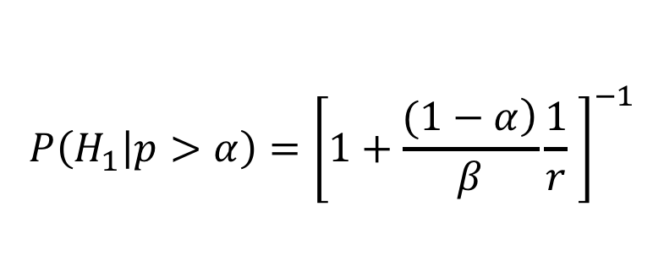
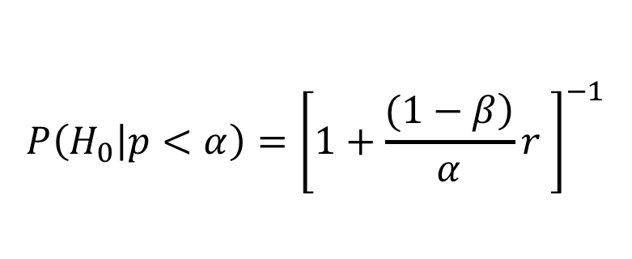
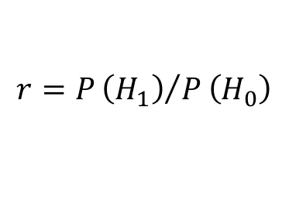
False discovery rates
Impact of ⍺=0.05 vs ⍺=0.05/7128 (7128 comparisons)
False Discovery Rate (FDR)
False Confirmation Rate (FCR)
Error rates
$$P\left(H_{0} | p<α\right)={\left[1+\frac{\left.(1−β\right)}{α}r \right]}^{−1}$$
$$P\left(H_{1} | p>α\right)={\left[1+\frac{\left.(1−α\right)}{β}\frac{1}{r} \right]}^{−1}$$
$$r=P{\left(H_{1}\right)}/P\left(H_{0}\right)$$
Error rates

Slide 26
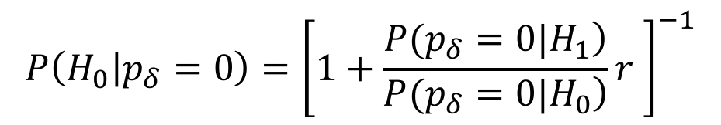
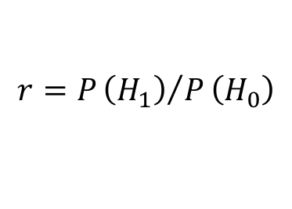
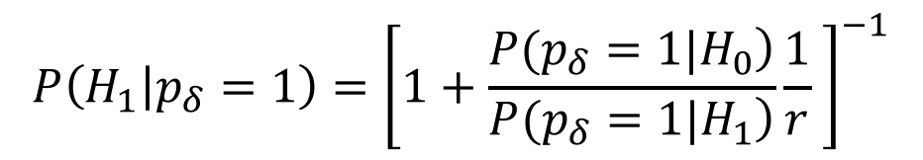
False discovery rates
Second-generation p-values
False Discovery Rate (FDR)
False Confirmation Rate (FCR)
Error Rates
$$P\left(H_{0} | p_{δ}=0\right)={\left[1+\frac{\left.P(p_{δ}=0|H_{1}\right)}{\left.P(p_{δ}=0|H_{0}\right)}r \right]}^{−1}$$
$$P\left(H_{1} | p_{δ}=1\right)={\left[1+\frac{\left.P(p_{δ}=1|H_{0}\right)}{\left.P(p_{δ}=1|H_{1}\right)}\frac{1}{r} \right]}^{−1}$$
$$r=P{\left(H_{1}\right)}/P\left(H_{0}\right)$$
Error Rates

Slide 27
r=1

Slide 28
r=1

Slide 29
r=1

Slide 30
r=1

Slide 31
r=1

Slide 32
r=1

Slide 33
r=1

Slide 34
FDRestimation Package
And val’s package

Slide 35
Things we couldn’t get in half day
Yi’s Variable Selection
Regression modeling

Slide 36
What they Learned
Long list

Slide 37
Remarks
Second-generation p-values…
Has three “Error” rates
Allows Type I and II rate to converge to zero
Control changes of inconclusive results
Controls error rate using science
Reduces the false discovery rate
Anchoring the scale of the effect size…
Eliminates most Type I Errors
Improves scientific translation of statistical model

Slide 38
Acknowledgements
Outrageous Claim (!?)
The SGPV achieves the inferential properties that many scientists hope, or believe, are attributes of the classic p-value.
Collaborators
William D. Dupont
Robert A. Greevy
Lucy D’Agostino McGowan
Valerie Welty
Jeffrey R. Smith
Yi Zuo
Thomas G Stewart
Website / Papers / Code
statisticalevidence.com
PLOS One ; TAS (In Press)
Google “Second-Generation p-value”
devtools::install_github("weltybiostat/sgpv")

